Slide 1
Tutorial 3
By Jeremy Lim

Slide 2
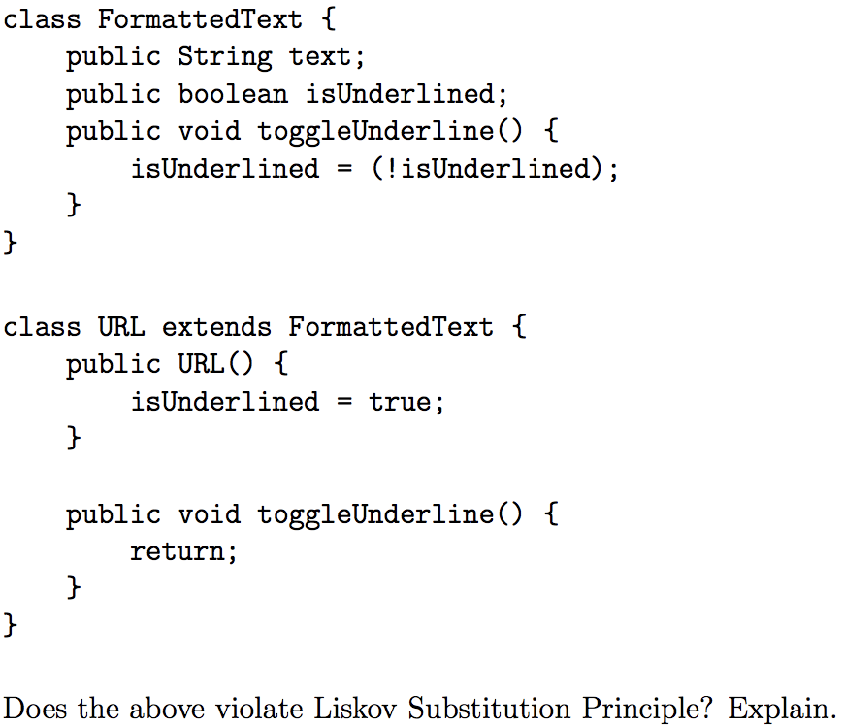
Q1
Does this violate LSP?

Slide 3
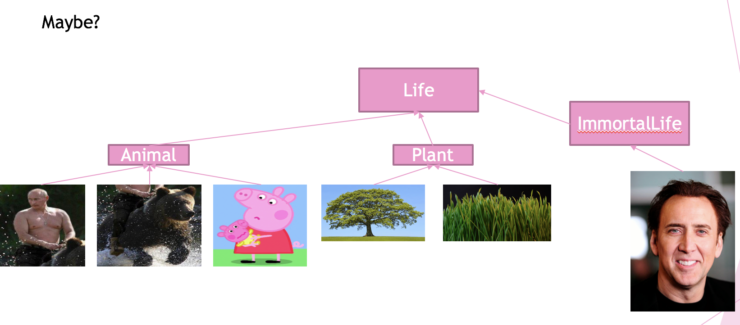
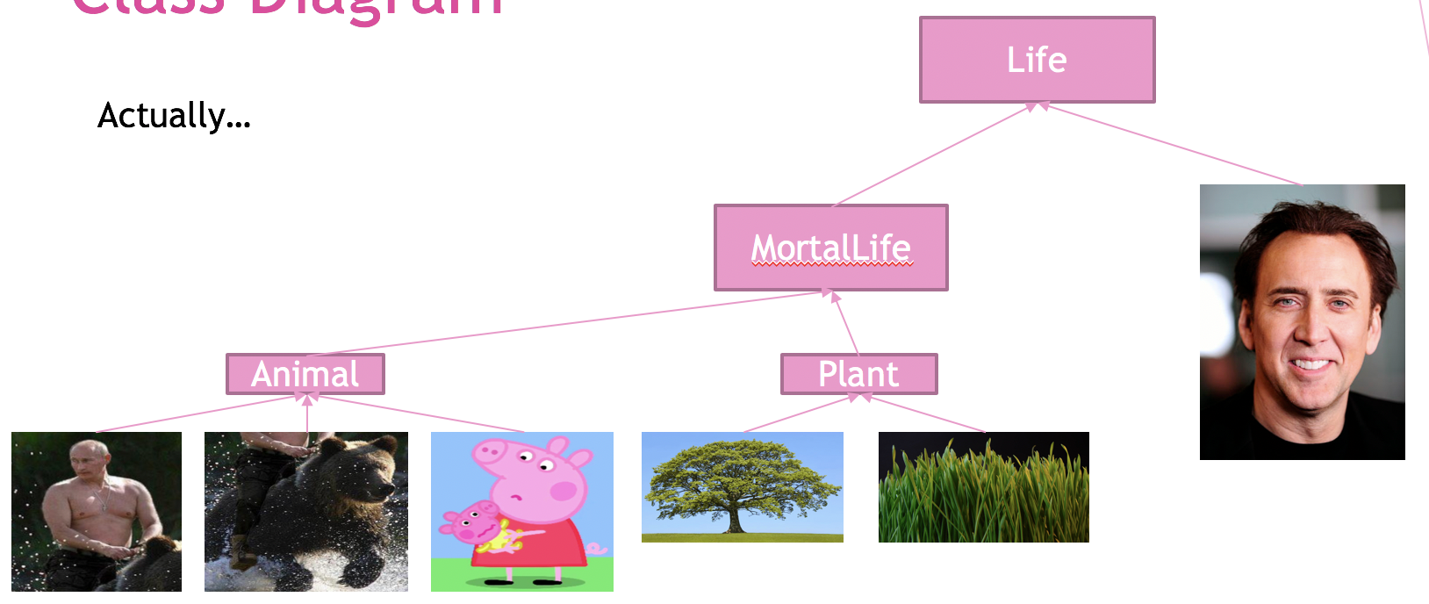
Recall
vs

Slide 4
Q1
Does this violate LSP?
Yes, the “desirable property” (purpose) of the method no longer holds as URL changes the behavior of toggleUnderline().

Slide 5
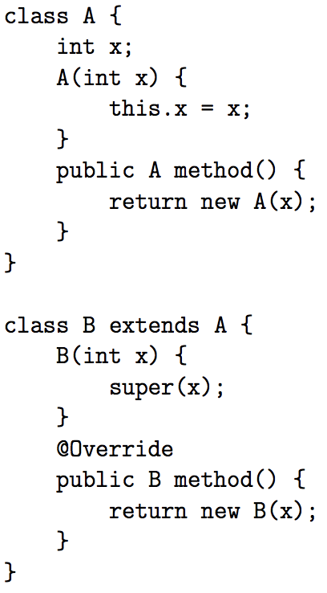
Q2
Does it compile?

Slide 6
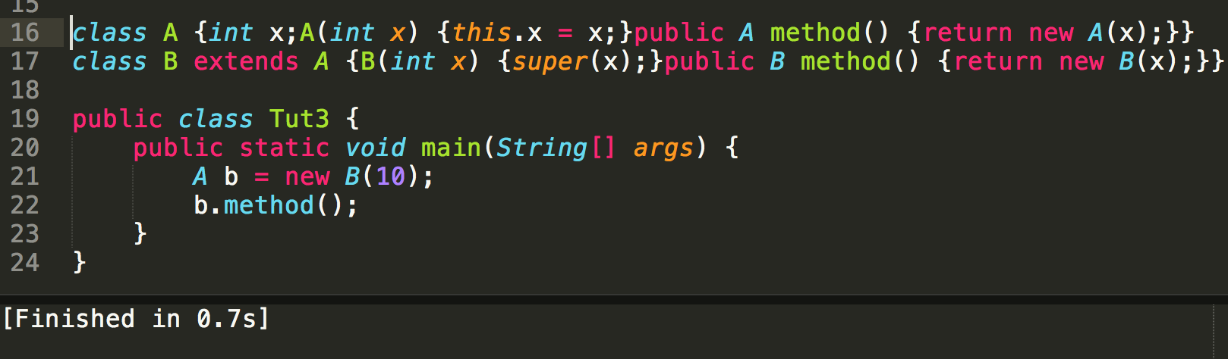
Yes.

Slide 7
Why?
A’s Methods
method() : A
A’s Implementation
method() : A
B’s Methods
method() : B
B’s Implementation
method() : B

Slide 8

Why?
A’s Methods
method() : A
A’s Implementation
method() : A
B’s Methods
method() : B
B’s Implementation
method() : B

Slide 9
Why?
A’s Methods
method() : A
A’s Implementation
method() : A
“But the signatures don’t match!!!”
B’s Methods
method() : B
B’s Implementation
method() : B

Slide 10
Why?
A’s Methods
method() : A
A’s Implementation
method() : A
“But the signatures don’t match!!!”
B’s Methods
method() : B
B’s Implementation
method() : B
A
method() : A
Instance of B can be returned as A
inherits
Same logic as storing instance of B in var of type A
B
method() : B

Slide 11
Q2
Does it compile?
B
B
A
A

Slide 12
No.
A’s Methods
method() : B
A’s Implementation
method() : B
A
method() : B
B expected
inherits
B’s Methods
method() : A
B’s Implementation
method() : A
B
method() : A
A received

Slide 13
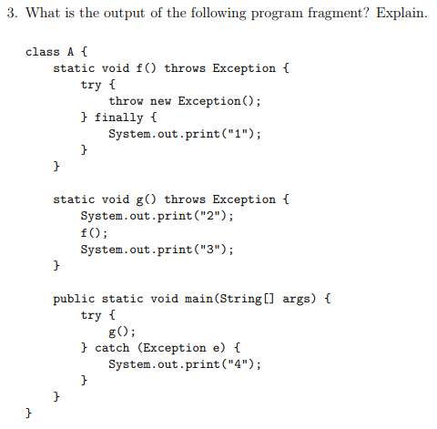
Q3
What is the output, and why?

Slide 14
Q3
3.
Key Point:
finally in a try-catch block executes before an external catch
4.
2.
Skipped
1.
5.

Slide 15
Q4
Design a class QA (and other classes) such that it can replace MCQ and TFQ
i.e. Imagine an exam system, each QA instance is 1 qns, and it can either be MCQ or TFQ

Slide 16
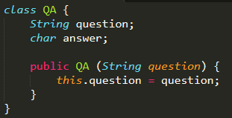
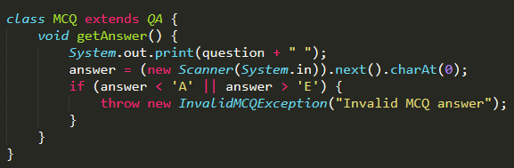
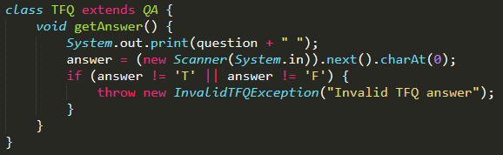
Q4
Step 1: Abstract out common code in TFQ and MCQ to a common place QA
MCQ and TFQ inherits from QA
InvalidMCQException and InvalidTFQException extends InvalidAnswerException
(+ more on the next slide)

Slide 17
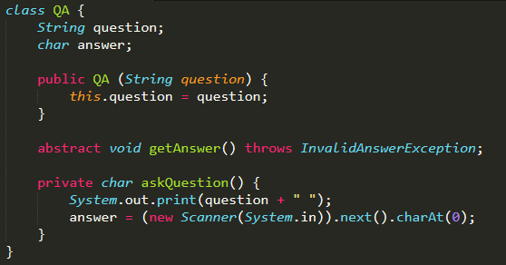
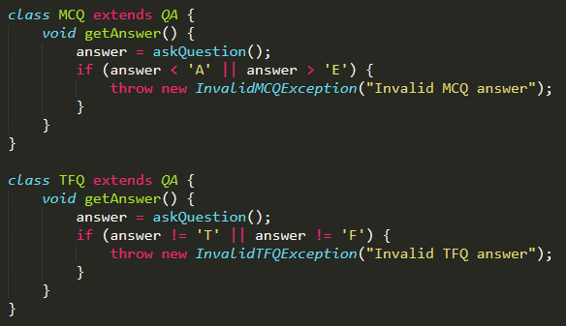
Q4
2 ways from here: First – Abstract input
abstract class QA {
protected

Slide 18
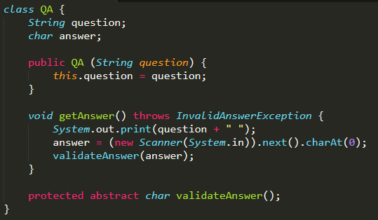
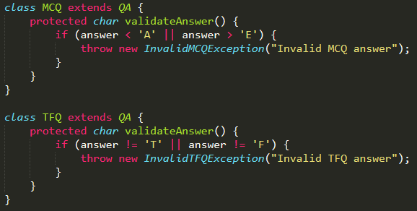
Q4
2 ways from here: Second – Abstract validation
abstract class QA {

Slide 19
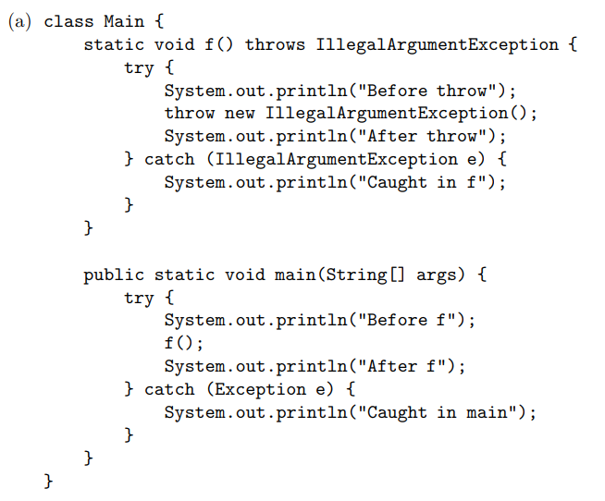
Q5
2.
Unreachable statement
Key Point:
Exception caught in first catch
3.
1.
4.

Slide 20
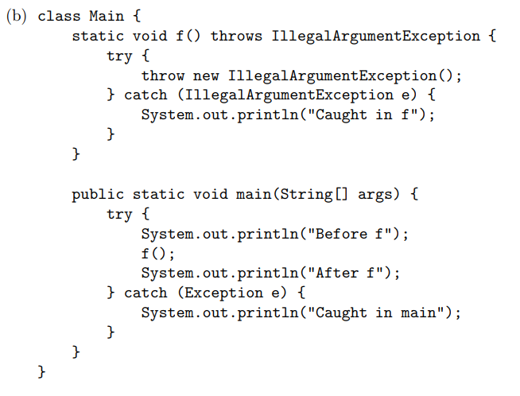
Q5
2.
3.
1.
4.

Slide 21
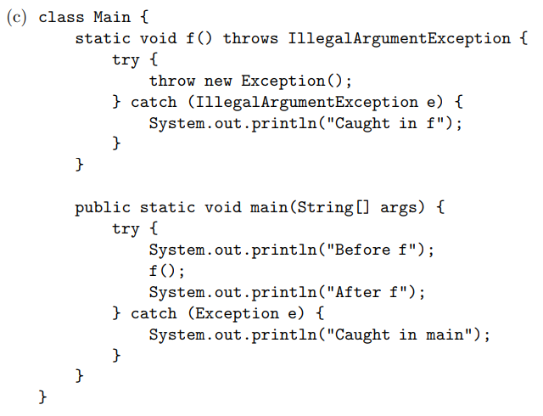
Q5
Incompatible type (Same as returning the wrong type)
2.
Exception is more general than IllegalArgumentException (not caught)
1.

Slide 22
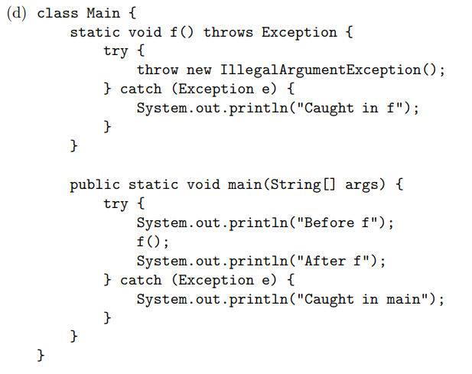
Q5
2.
3.
1.
4.

Slide 23
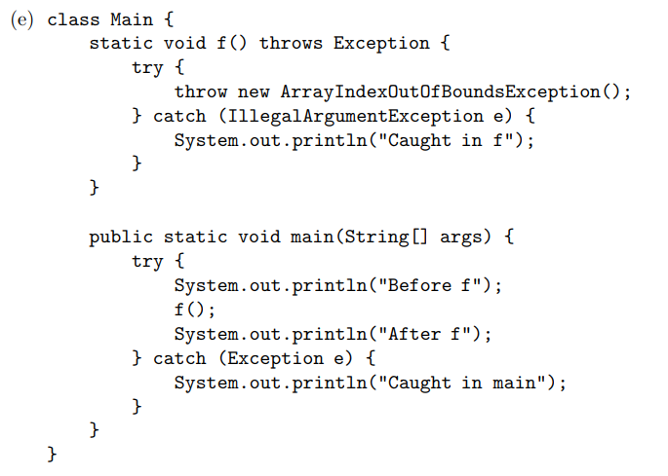
Q5
2.
Key Point:
Exception caught in first matching catch, program executes from there
1.
3.

Slide 24
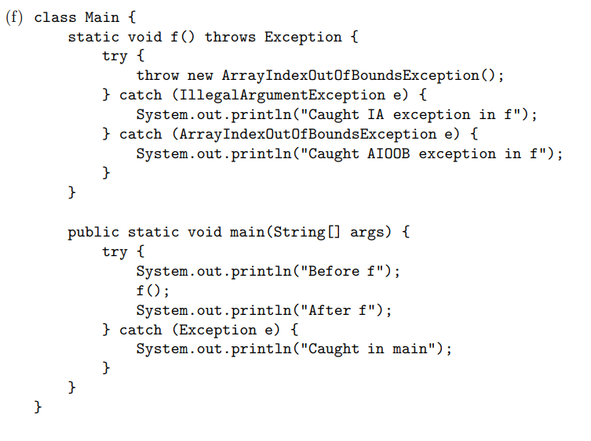
Q5
2.
3.
1.
4.

Slide 25
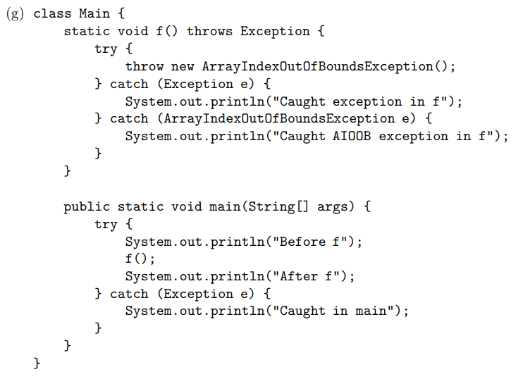
Q5
2.
3.
Never reaches here (Compile Error)
Key Point:
Catch-all at the end, or better, don’t catch Exception
1.

Slide 26
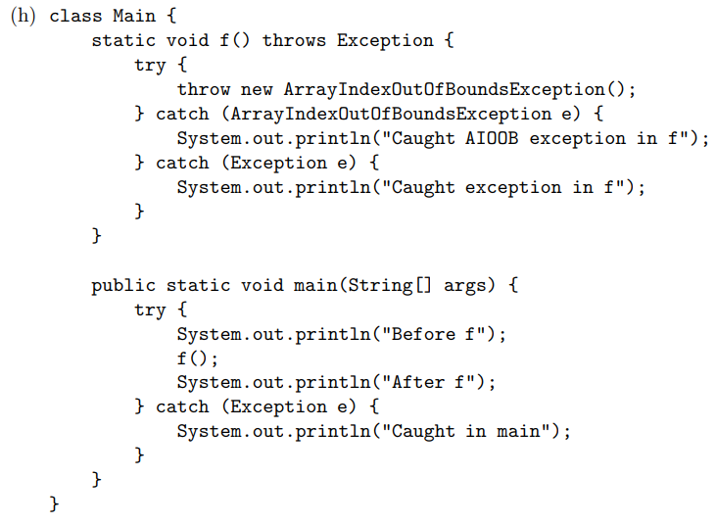
Q5
2.
3.
1.
4.

Slide 27
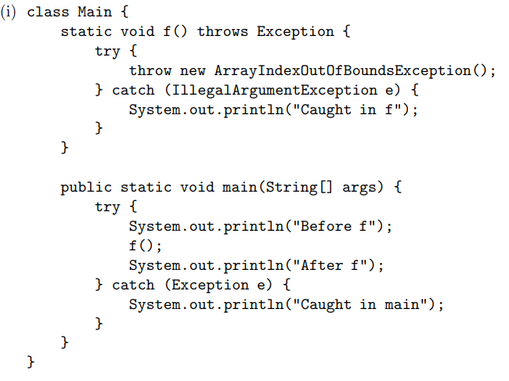
Q5
2.
1.
3.

